Slide 1



SWATIMALI@SOMAIYA.EDU
DATA STRUCTURES – TYPES AND ADT

Slide 2

Data structures Implementation

Slide 3
Variables, arrays and Pointers
Variable
Pointer variable
Memory allocation
Array allocations
Dynamic memory allocation

Slide 4
Memory
Memory – Main memory, Secondary memory
How do you differentiate : RAM, main memory, Primary memory, secondary memory, HDD???
Main memory and program execution
Can a user have access to entire main memory space?
Can a program be larger than main memory?

Slide 5
How Memory are allocated?
Contiguous memory allocation
Memory is allocated in a single continuous block
Often used for arrays and other fixed-size data structures
Non-contiguous memory allocation
Memory is allocated in multiple separate blocks.
Used in linked lists, hash tables, and other dynamic data structures.

Slide 6
How Memory are allocated?
Static memory allocation
Memory is allocated at compile time and remains fixed throughout the program's execution.
Dynamic memory allocation
Memory is allocated at runtime as needed.

Slide 7
Static vs Dynamic memory allocation
 | Static memory allocation | Dynamic memory allocation
Definition: | Memory is allocated at compile time. | Memory is allocated at runtime.
Characteristic: | The size of the memory allocated is fixed and cannot be changed during runtime. | The size of the memory allocated can change as needed during execution.
Predictability: | Memory usage is known ahead of time. | Memory requirements not known beforehand
Performance: | No runtime overhead for allocation and deallocation. | Runtime overheand for allocation and deallocation of memory; Risk of memory leaks, fragmentation, and dangling pointers
Ease of use | Easy to implement and manage as the memory layout is fixed. | Managing dynamic memory is more complex and error-prone.
Flexibility | Memory size cannot be changed after allocation. | Can allocate and deallocate memory as required.

Slide 8
Static vs Dynamic memory allocation
 | Static memory allocation | Dynamic memory allocation
Efficient memory usage | May lead to inefficient memory usage if allocated size is not optimal. | Allocates only the amount of memory needed at runtime.
Usage | Not suitable for data structures whose size changes during execution. | Ideal for data structures that grow or shrink, like linked lists, trees, and graphs.
Memory allocation | Managed by the compiler. | Managed by the programmer.
Use Cases: | Global and static variables, Fixed-size arrays, Constants. | Dynamic data structures like linked lists, trees, and graphs, Applications with varying memory requirements, Situations where the size of the data is not known at compile time.
Example | int arr[10]; // Static array of size 10 | int *arr = (int *)malloc(10 * sizeof(int)); // Dynamic array of size 10 // Don't forget to free the memory free(arr);

Slide 9
Classification of Data Structure
Primitive Data Structure
Non-Primitive Data Structure

Slide 10
Classification of Data Structures
Data structure
Primitive DS
Non-Primitive DS
Integer
Float
Character
Pointer

Slide 11
Classification of Data Structures
Non-Primitive DS
Linear List
Non-Linear List
Array
Queue
Graph
Trees
Link List
Stack

Slide 12
Primitive data structures
Basic structures that are directly operated upon by the machine instructions.
Usually built into the language, such as an integer, a float.

Slide 13
Non-Primitive data structures
More sophisticated data structures.
Derived from the primitive data structures.
Emphasize on structuring of a group of homogeneous (same type) or heterogeneous (different type) data items.

Slide 14
Data structures and their representations

Slide 15
Stack
Data4
Top
Data3
Data2
Data1

Slide 16
Typical Applications of Stack in real life
Undo Mechanisms in Software
Backtracking Algorithms
Function Call Management
Infix to postfix conversion
recursion
Expression Evaluation
Syntax Parsing
Browser History Management

Slide 17
Queue
Data4
Rear
Data3
Data2
Data1
Front

Slide 18
Typical Applications of Queue in real life
Customer Service Systems
Task Scheduling
Buffer Management in OS
Resource Allocation in OS
Emergency Services –PQ
Process Scheduling, waiting queues
Palindrome Checking – Dequeues
Any waiting queue- Bus, restaurant, ticket window, etc

Slide 19
List- A Flexible structure that can grow and shrink on demand
Head
D
A
M
K
Temp
Nil
Head
K
D
A
M
Temp
Nil

Slide 20
Typical Applications of Linked Lists in real life
Dynamic Memory Allocation – managing memory blocks
Navigation Systems - route as a sequence of points
Browser History Management - navigate back and forth through the history.
Music or Video Playlist Management
Round Robin Scheduling
Multiplayer Board Games
Database Indexing

Slide 21
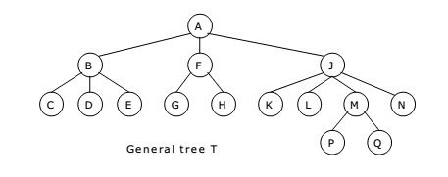
Tree
Image courtesy: ExamRadar.com

Slide 22
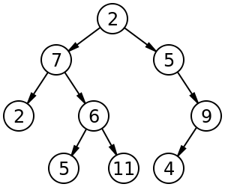
Binary Tree, Binary search tree and Heaps
Image courtesy: ExamRadar.com

Slide 23
Typical Applications of Trees in real life
Hierarchical file systems
Family tree
Organizational tree
Game tree
Databases and Indexing
DNS
Data Compression
Decision trees
Parse Trees in Natural Language Processing
Routing Algorithms in Networks - MST

Slide 24
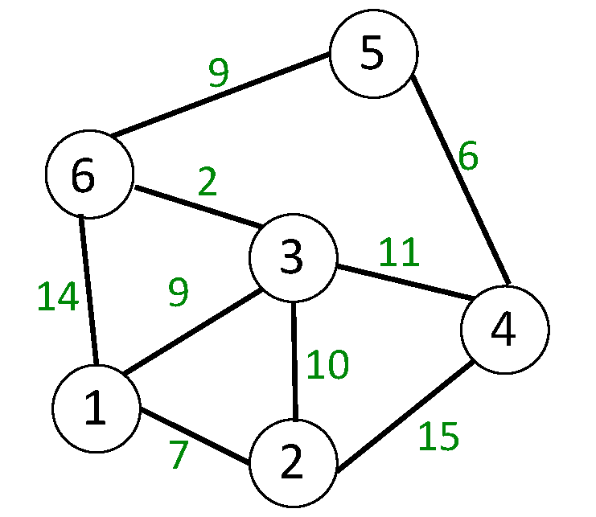
Graph
Image courtesy: Medium.com

Slide 25
Typical Applications of Graph in real life
Social Networks
Transportation Networks
Internet and Web Page Link Analysis- Web pages are nodes, and hyperlinks as edges.
Recommendation Systems- model relationships between users and items.
Circuit Design
Map Navigation and GPS Systems
Mind maps
Internet and Telecommunications- routing

Slide 26
Abstract Data Type and Data Structure
Definition:-
Abstract Data Types (ADTs) stores data and allow various operations on the data to access and change it.
A mathematical model, together with various operations defined on the model
An ADT is a collection of data and associated operations for manipulating that data

Slide 27
Abstract Data Type
ADTs support abstraction, encapsulation, and information hiding.
Abstraction is the structuring of a problem into well-defined entities by defining their data and operations.
The principle of hiding the used data structure and to only provide a well-defined interface is known as encapsulation.

Slide 28
ADT Operations
Every Collection ADT should provide a way to:
Create data structure
add an item
remove an item
find, retrieve, or access an item
No single data structure works well for all purposes, and so it is important to know the strengths and limitations of several of them

Slide 29
Communicating your ideas in CSE
Variable naming
Comments
Function declarations
Algorithm writing
ADT writing

Slide 30
ADT Syntax : Value Definition
Abstract typedef < ParameterType Parameter1, ParameterType Parameter2……, ParameterType ParameterN > ADTType
condition:

Slide 31
ADT Syntax : Operator definition
Abstract ReturnType OperationName (ParameterType Parameter1, ParameterType Parameter2……, ParameterType ParameterN)
Precondition:
Postcondition:
OR
Abstract ReturnType OperationName (Parameter1, Parameter2……, ParameterN)
ParameterType Parameter1, ParameterType Parameter2……, ParameterType ParameterN
Precondition:
Postcondition:

Slide 32
Abstract Data Structure
Logical Definition
Mathematical definition
ADTs represent concepts
Free from hardware or software dependency
Operation name is assumed as the return variable name

Slide 33
Abstraction
The process of isolating implementation details and extracting only essential property from an entity
Hence, abstractions in a program:
Data abstraction :What operations are needed by the data
Functional abstraction : What is the purpose of a function (algorithm)
Program = data + algorithms
Courtsey: https://www.comp.nus.edu.sg/~stevenha/cs1020e/lectures/L5%20-%20ADT.pdf

Slide 34
ADTs
Abstract Data Type (ADT):
End result of data abstraction
A collection of data together with a set of operations on that data
ADT = Data + Operations
ADT is a language independent concept
Different language supports ADT in different ways
In C++, the class construct is the best match
Courtsey: https://www.comp.nus.edu.sg/~stevenha/cs1020e/lectures/L5%20-%20ADT.pdf

Slide 35
What ADT doesn’t specify?
Algorithm
Platform
h/w
s/w
Programming Language

Slide 36
What ADT does specify?
Allowed values which follow the constraint(s) in definition
Permitted operations on the data type being created
Operations must have
Meaningful name
Return type
List of input parameters
Data types of all input parameters

Slide 37
Specify return types and inputs
Data type: integer
Operations:
Addition
Subtraction
Compare
Sum of digits
Log₁₀
Specify name, no of inputs, their data types, data type of operation result

Slide 38
Specify return types and inputs
Data type: integer array
Specify name, no of inputs, their data types, data type of operation result
Operation:
Sum of elements
Add/delete an element into/from array
Compare two arrays
Head or tail value of array

Slide 39
ADT and Operations
How do you perform following operations?
String a,b ; a+b, a/b, x : ? y
Integer x,y ; x+y, x/y, x :? y
Real m,n ; m+n, m/n, m : ? y
Same operations on different data type might have different processes
All data types might not follow same operations

Slide 40
IS ADT a function?

Slide 41
Important Properties of ADT
Specification: The supported operations of the ADT
Implementation: Data structures and actual coding to meet the specification
Courtsey: https://www.comp.nus.edu.sg/~stevenha/cs1020e/lectures/L5%20-%20ADT.pdf

Slide 42
ADT : Specification and Implementation
Specification and implementation are disjointed:
One specification
One or more implementations
Using different data structure
Using different algorithm
Users of ADT:
Aware of the specification only
Usage only base on the specified operations
Do not care / need not know about the actual implementation
i.e. Different implementation do not affect the user
Courtsey: https://www.comp.nus.edu.sg/~stevenha/cs1020e/lectures/L5%20-%20ADT.pdf

Slide 43
Example ADT : String
Definition: String is a sequence of characters
Operations:
StringLength
StringCompare
StringConcat
StringCopy

Slide 44
Example ADT : String
Value Definition
Abstract Typedef StringType<<Chars>>
Condition: None (A string may contain n characters where n=>0)

Slide 45
Example ADT : String Operator Definition
1. abstract Integer StringLength (StringType String)
Precondition: None (A string may contain n characters where n=>0)
Postcondition: Stringlength= NumberOfCharacters(String)

Slide 46
Example ADT : String Operator Definition
2. abstract StringType StringConcat( StringType String1, StringType String2)
Precondition: None
Postcondition: StringConcat= String1+String2 / All the characters in Strings1 immediately followed by all the characters in String2 are returned as result.

Slide 47
Example ADT : String Operator Definition
3. abstract Boolean StringCompare( StringType String1, StringType String2)
Precondition: None
Postcondition: StringCompare= True if strings are equal, StringCompare= False if they are unequal . (Function returns 1 if strings are same, otherwise zero)

Slide 48
Example ADT : String Operator Definition
4. abstract StringType StringCopy( StringType String1, StringType String2)
Precondition: None
Postcondition: StringCopy: String1= String2 / All the characters in Strings2 are copied/overwritten into String1.

Slide 49
Example ADT : Rational Number
Definition: expressed as the quotient or fraction of two integers,
Operations:
IsEqualRational()
MultiplyRationa()
AddRational()

Slide 50
Example ADT : Rational Number
Value Definition
abstract TypeDef<integer, integer> RATIONALType;
Condition: RATIONALType [1]!=0;

Slide 51
Example ADT : Rational Number Operator Definition
abstract RATIONALType makerational<a,b>
integer a,b;
Preconditon: b!=0;
postcondition :
makerational [0] =a; makerational [1] =b;
abstract RATIONALtype add<a,b>
RATIONALType a,b;
Precondition: none
postcondition :
add[0] = a[0]*b[1]+b[0]*a[1]
add[1] = a[1] * b[1]

Slide 52
Example ADT : Rational Number Operator Definition
abstract RATIONALType mult<a, b>
RATIONALType a,b;
Precondition: none
postcondition
mult[0] = = a[0]*b[0]
mult[1] = = a[1]*b[1]
abstract RetunType? Equal<a,b>
RATIONALType a,b;
Precondition: none
postcondition equal = |a[0] * b[1] = = b[0] * a[1];

Slide 53
Abstract Data Types: Advantages
Hide the unnecessary details by building walls around the data and operations
o that changes in either will not affect other program components that use them
Functionalities are less likely to change
Localize rather than globalize changes
Help manage software complexity
Easier software maintenance
Courtsey: https://www.comp.nus.edu.sg/~stevenha/cs1020e/lectures/L5%20-%20ADT.pdf

Slide 54
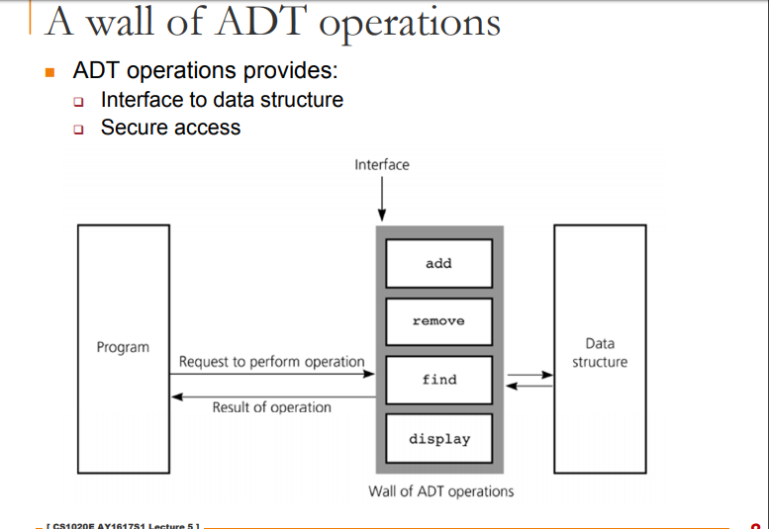
Courtsey: https://www.comp.nus.edu.sg/~stevenha/cs1020e/lectures/L5%20-%20ADT.pdf

Slide 55
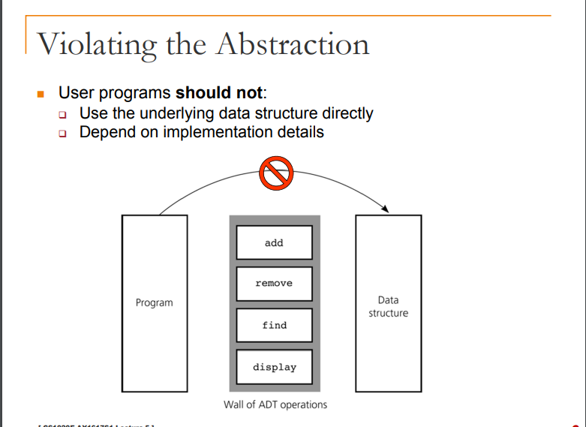
Courtsey: https://www.comp.nus.edu.sg/~stevenha/cs1020e/lectures/L5%20-%20ADT.pdf

Slide 56
ADT Implementation
Computer languages do not provide complex ADT packages.
To create a complex ADT, it is first implemented and kept in a library.

Slide 57
Write Array as ADT
Operations:
Create
Add
Delete
Sum
Search
SizeOfArray

Slide 58
Thank you

